Slide 1
Merit Timecard Coding
Linda Gruetzmacher, Payroll Manager

Slide 2
Agenda
Hours Towards Overtime
Holiday
Call Back
Compensatory Time Limits and Payouts
Questions

Slide 3
Hours Towards Overtime
Over 40 hours – when is it overtime and when is it paid as additional regular?
Hours actually worked count towards overtime (except holiday)
Leave/Holiday hours don’t count towards overtime
Hours actually worked
Regular, Excused Duty, Callback (minimum 3)

Slide 4
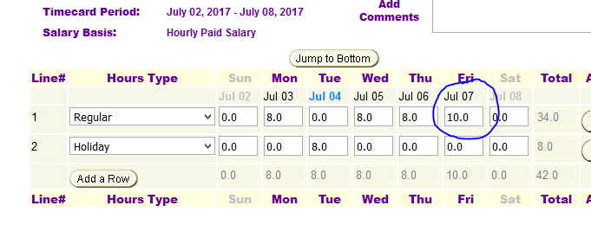
Example of Hours Towards Overtime (holiday not worked)

Slide 5
Hours Towards Overtime
When will extra hours at straight time be paid?
IF timecard is on time!
Salary Adjust for Hourly Paid Salary employees

Slide 6
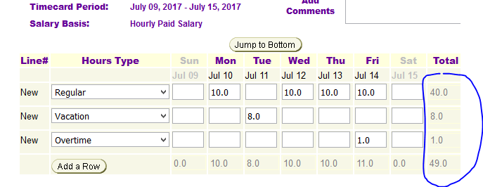
Example of Hours Towards Overtime Vacation does not count towards overtime. Worked 41 hours.

Slide 7
Holiday
How many hours of Holiday benefit?
8 Hours for fulltime
Part time prorated - 8 x FTE (e.g 8 x .50 = 4 hours) , including phased retirees
Or, number weekly hours/5 (e.g. 20/5 = 4 hours for half time)

Slide 8
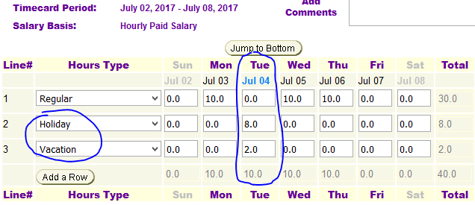
Holiday Full time, normally works four 10 hour days

Slide 9
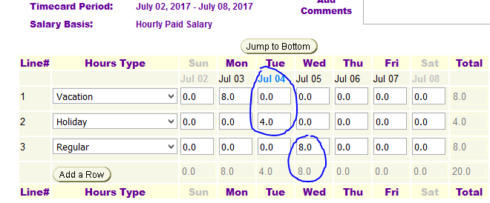
Holiday Half time, normally works 8-8-4, flexes time this week

Slide 10
Holiday
Holiday observed on UNI observed date IF work Monday through Friday, otherwise on actual holiday
Banked Holiday
Work on holiday – Holiday Premium Pay (or CompEarned), and Holiday does not count towards overtime. No pyramiding.
Partial shift on holiday

Slide 11
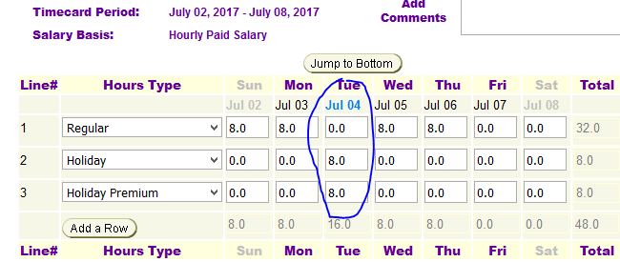
Holiday Worked 8 hours on holiday. Code Holiday! HP or CE

Slide 12
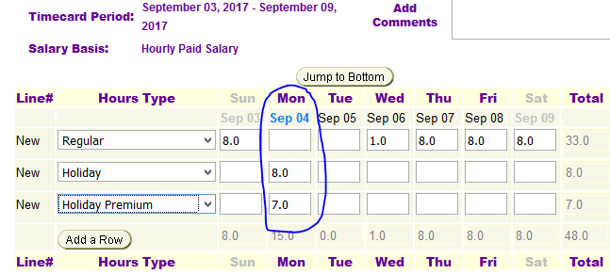
Holiday Split shifts- 7 hours on actual holiday, 7 hrs Holiday Premium

Slide 13
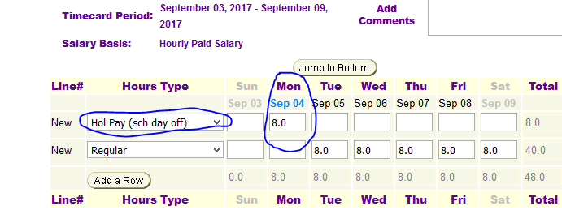
Holiday Holiday normal scheduled day off – Hol Pay(sch day off) or Banked Hol Earned

Slide 14
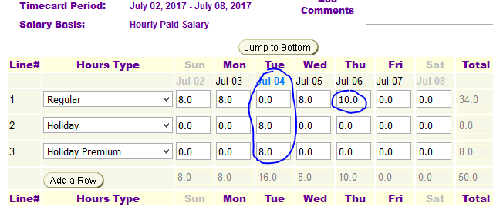
Holiday worked holiday, also worked more than 40 – no pyramiding

Slide 15
Call Back
When called in to work not adjacent to normal hours – mostly Physical Plant
Credit for minimum of 3 hours (even if only work 1)
All hours count as regular towards overtime
Code 3 hours (or more) Call Back

Slide 16
Compensatory Time Limits and Payouts
Compensatory time balances limited to 80 hours
Balance in excess of 80 hours paid on following month’s paycheck
No planned fiscal year payout after this year
Employee contact Payroll to request payout in next payrun

Slide 17
Questions?

